Slide 1
Core Strength Exercises
From the Mayo Clinic website

Slide 2
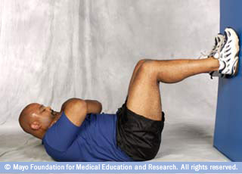
1. Abdominal crunch
Lie on your back and place your feet on a wall so that your knees and hips are bent at 90-degree angles. Tighten your abdominal muscles.
Raise your head and shoulders off the floor. To avoid straining your neck, cross your arms on your chest rather than locking them behind your head. Hold for three deep breaths.
Return to the start position and repeat.

Slide 3
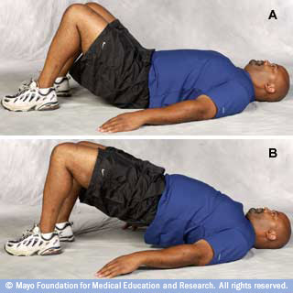
2. Bridge
Lie on your back and place your feet on a wall so that your knees and hips are bent at 90-degree angles. Tighten your abdominal muscles.
Raise your head and shoulders off the floor. To avoid straining your neck, cross your arms on your chest rather than locking them behind your head. Hold for three deep breaths.
Return to the start position and repeat.

Slide 4
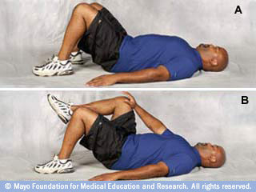
3. Single-leg abdominal press
Lie on your back with your knees bent (A). Keep your back in a neutral position, not arched and not pressed into the floor. Avoid tilting your hips. Tighten your abdominal muscles.
Raise your right leg off the floor so that your knee and hip are bent at 90-degree angles. Rest your right hand on top of your right knee (B).
Push your hand against your knee while using your abdominal muscles to pull your knee toward your hand. Keep your arm straight. Hold for three deep breaths.
Return to the start position and repeat using your left hand and left knee.

Slide 5
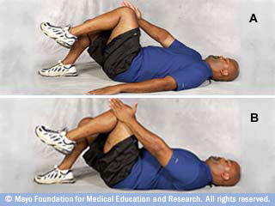
4. Single-leg abdominal press vars
Opposite hand on opposite knee. Push your right hand against your left knee while pulling your knee toward your hand (A). You'll be pushing and pulling across the center of your body. Hold for three deep breaths. Repeat using your other hand and leg.
Hand on outside of knee. Place your left hand along the side of your left knee (B). Use your hand to push your leg inward. At the same time, create resistance by pushing your knee away from the center. Hold for three deep breaths. Repeat using your other hand and leg.

Slide 6
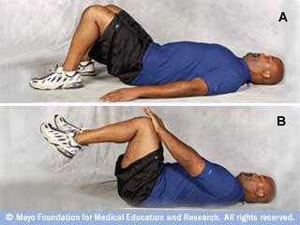
5. Double-leg abdominal press
Lie on your back with your knees bent (A). Keep your back in a neutral position, not arched and not pressed into the floor. Avoid tilting your hips. Tighten your abdominal muscles.
Raise your legs off the floor, one at a time, so that your knees and hips are bent at 90-degree angles. Rest your hands on top of your knees (B).
Push your hands against your knees while using your abdominal muscles to pull your knees toward your hands. Keep your arms straight. Hold for three deep breaths.
Return to the start position and repeat.

Slide 7
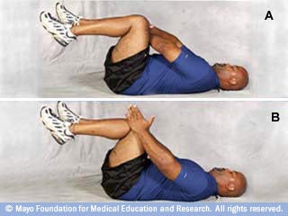
6. Double-leg abdominal press vars
Opposite hands on opposite knees. Place each hand on the opposite knee, toward the inside of the knee (A). Your arms will cross over each other. Push your hands against your knees while pulling your knees toward your hands. Hold for three deep breaths. Repeat.
Hands on outside of knees. Place your hands along the sides of your knees (B). Use your hands to push your knees inward. At the same time, create resistance by pushing your knees away from the center. Hold for three deep breaths. Repeat.

Slide 8
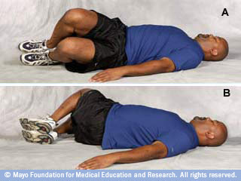
7. Segmental rotation
Lie on your back with your knees bent and your back in a neutral position. Tighten your abdominal muscles.
Keeping your shoulders on the floor, let your knees fall slowly to the left (A). Go only as far as is comfortable. You should feel a stretch, but not pain. Hold for three deep breaths.
Return to the start position. Repeat the exercise to the right (B).

Slide 9
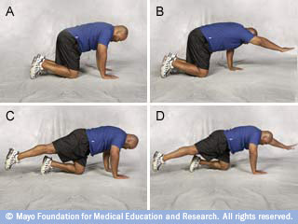
8. Quadruped
Start on your hands and knees. Place your hands directly below your shoulders, and align your head and neck with your back (A). Tighten your abdominal muscles.
Raise your right arm off the floor and reach ahead (B). Hold for three deep breaths. Lower your right arm and repeat with your left arm.
Raise your right leg off the floor (C). Tighten your trunk muscles for balance. Hold for three deep breaths. Lower your right leg and repeat with your left leg.
For added challenge, raise your left arm and your right leg at the same time (D). Repeat with your right arm and left leg.

Slide 10
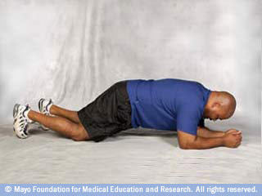
9. Modified plank
Lie on your stomach. Raise yourself up so that you're resting on your forearms and your knees. Align your head and neck with your back, and place your shoulders directly above your elbows. Tighten your abdominal muscles.
Create resistance by pressing your elbows and your knees toward one another. Neither should move from their positions on the floor. Hold for three deep breaths.
Return to the start position and repeat.

Slide 11
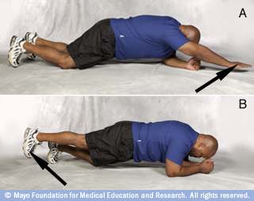
10. Modified plank variations
Lie on your stomach. Raise yourself up so that you're resting on your forearms and your knees. Align your head and neck with your back, and place your shoulders directly above your elbows. Tighten your abdominal muscles.
Raise your right arm off the floor (A). Hold for three deep breaths. Repeat with your left arm.
Raise your right leg off the floor (B). Hold for three deep breaths. Repeat with your left leg.
For added challenge, raise your left arm and your right leg at the same time. Repeat with your right arm and left leg.

Slide 12
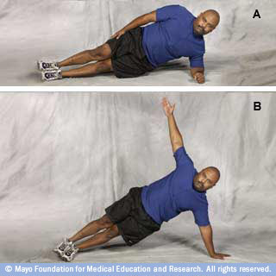
11. Side plank
Lie on your left side, raising yourself onto your left forearm (A). Place your left shoulder directly above your left elbow, keeping your shoulders, hips and knees in alignment. Rest your right arm along the side of your body.
Tighten your abdominal muscles. Hold for three deep breaths. Repeat on your right side.
For added challenge, balance on your left hand. Raise your hips off the floor and extend your right hand toward the ceiling (B). Hold for three deep breaths. Repeat on your right side.

Slide 13
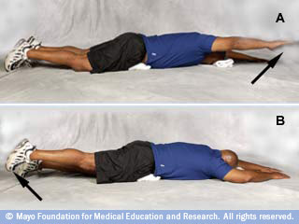
12. Superman
Lie on your stomach with a rolled towel or a small pillow under your hips to support your back. You might also use a folded towel to support your head. Tighten your abdominal muscles.
Raise your right arm off the floor (A). Hold for three deep breaths. Lower your right arm and repeat with your left arm.
Raise your right leg off the floor (B). Hold for three deep breaths. Lower your right leg and repeat with your left leg.

Slide 14
1. Abdominal crunch
Lie on your back and place your feet on a wall so that your knees and hips are bent at 90-degree angles. Tighten your abdominal muscles.
Raise your head and shoulders off the floor. To avoid straining your neck, cross your arms on your chest rather than locking them behind your head. Hold for three deep breaths.
Return to the start position and repeat.

Slide 15
1. Abdominal crunch
Lie on your back and place your feet on a wall so that your knees and hips are bent at 90-degree angles. Tighten your abdominal muscles.
Raise your head and shoulders off the floor. To avoid straining your neck, cross your arms on your chest rather than locking them behind your head. Hold for three deep breaths.
Return to the start position and repeat.

